Slide 1
MENA CONCENTRATION & UPWARD MOBILITY
(National, county-level)

Slide 2
SUMMARY STATISTICS OF MENA CONCENTRATION

Slide 3
Summary Stats – All Counties
No. of counties | 3,127
Mean | 0.000799
Std. Dev. | 0.0036
Median | 0
Min. | 0
Max. | 0.07226
Percentile | MENA concentration
1 | 0
25 | 0
50 | 0
75 | 0
90 | 0.0015
95 | 0.0046
99 | 0.0176

Slide 4
Summary Stats – Counties w/ Nonzero MENA Concentration
No. of counties | 456
Mean | 0.0055
Std. Dev. | 0.0080
Median | 0.0027
Min. | 0.00013
Max. | 0.07226
Percentile | MENA concentration
1 | 0.00024
25 | 0.0012
50 | 0.0027
75 | 0.00636
90 | 0.01288
95 | 0.01965
99 | 0.03631

Slide 5
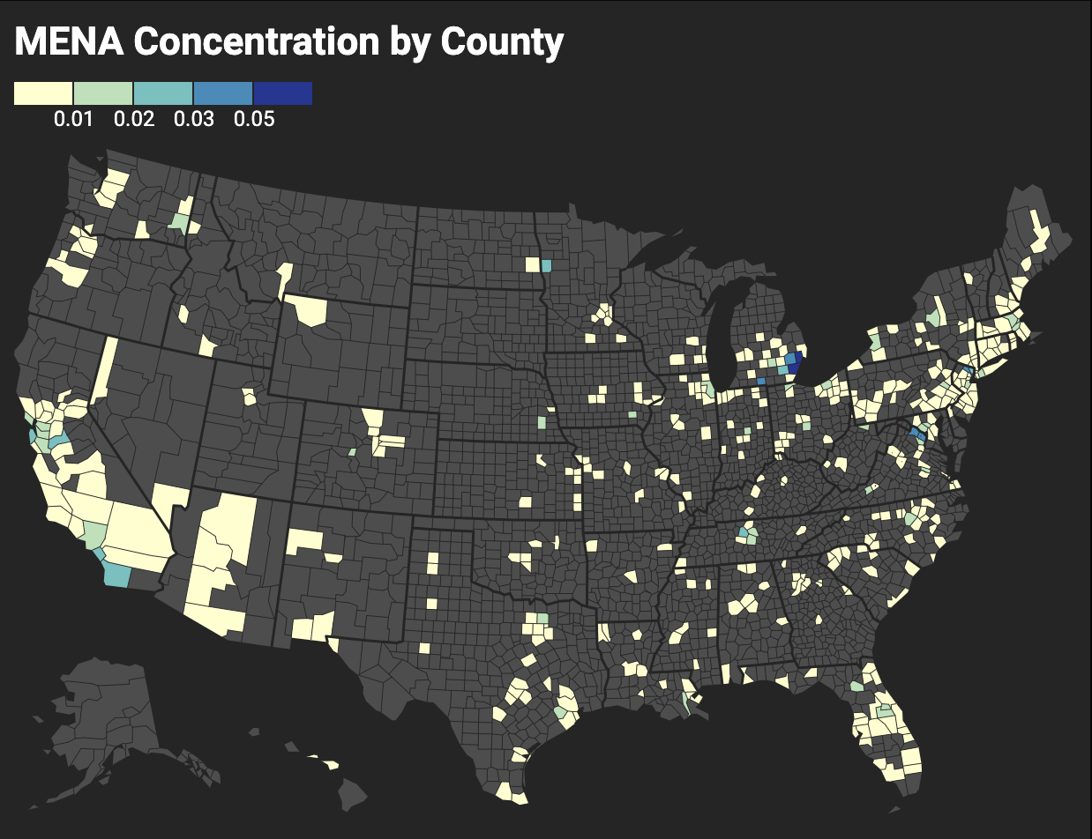

Slide 6
IMPORTANT NOTES ABOUT CHARTS

Slide 7
For coefficients of all scatterplots:
Universe is all tracts with a nonzero MENA concentration
Standard errors in parentheses
***p < 0.01, **p < 0.05, *p < 0.1
For all bar charts:
95% confidence intervals shown
”Median” refers to median MENA concentration of tracts with nonzero MENA concentration
For Michigan, this is 0.0518
All health outcome data sourced from CDC PLACES datasets

Slide 8
UPWARD MOBILITY CHARTS

Slide 9
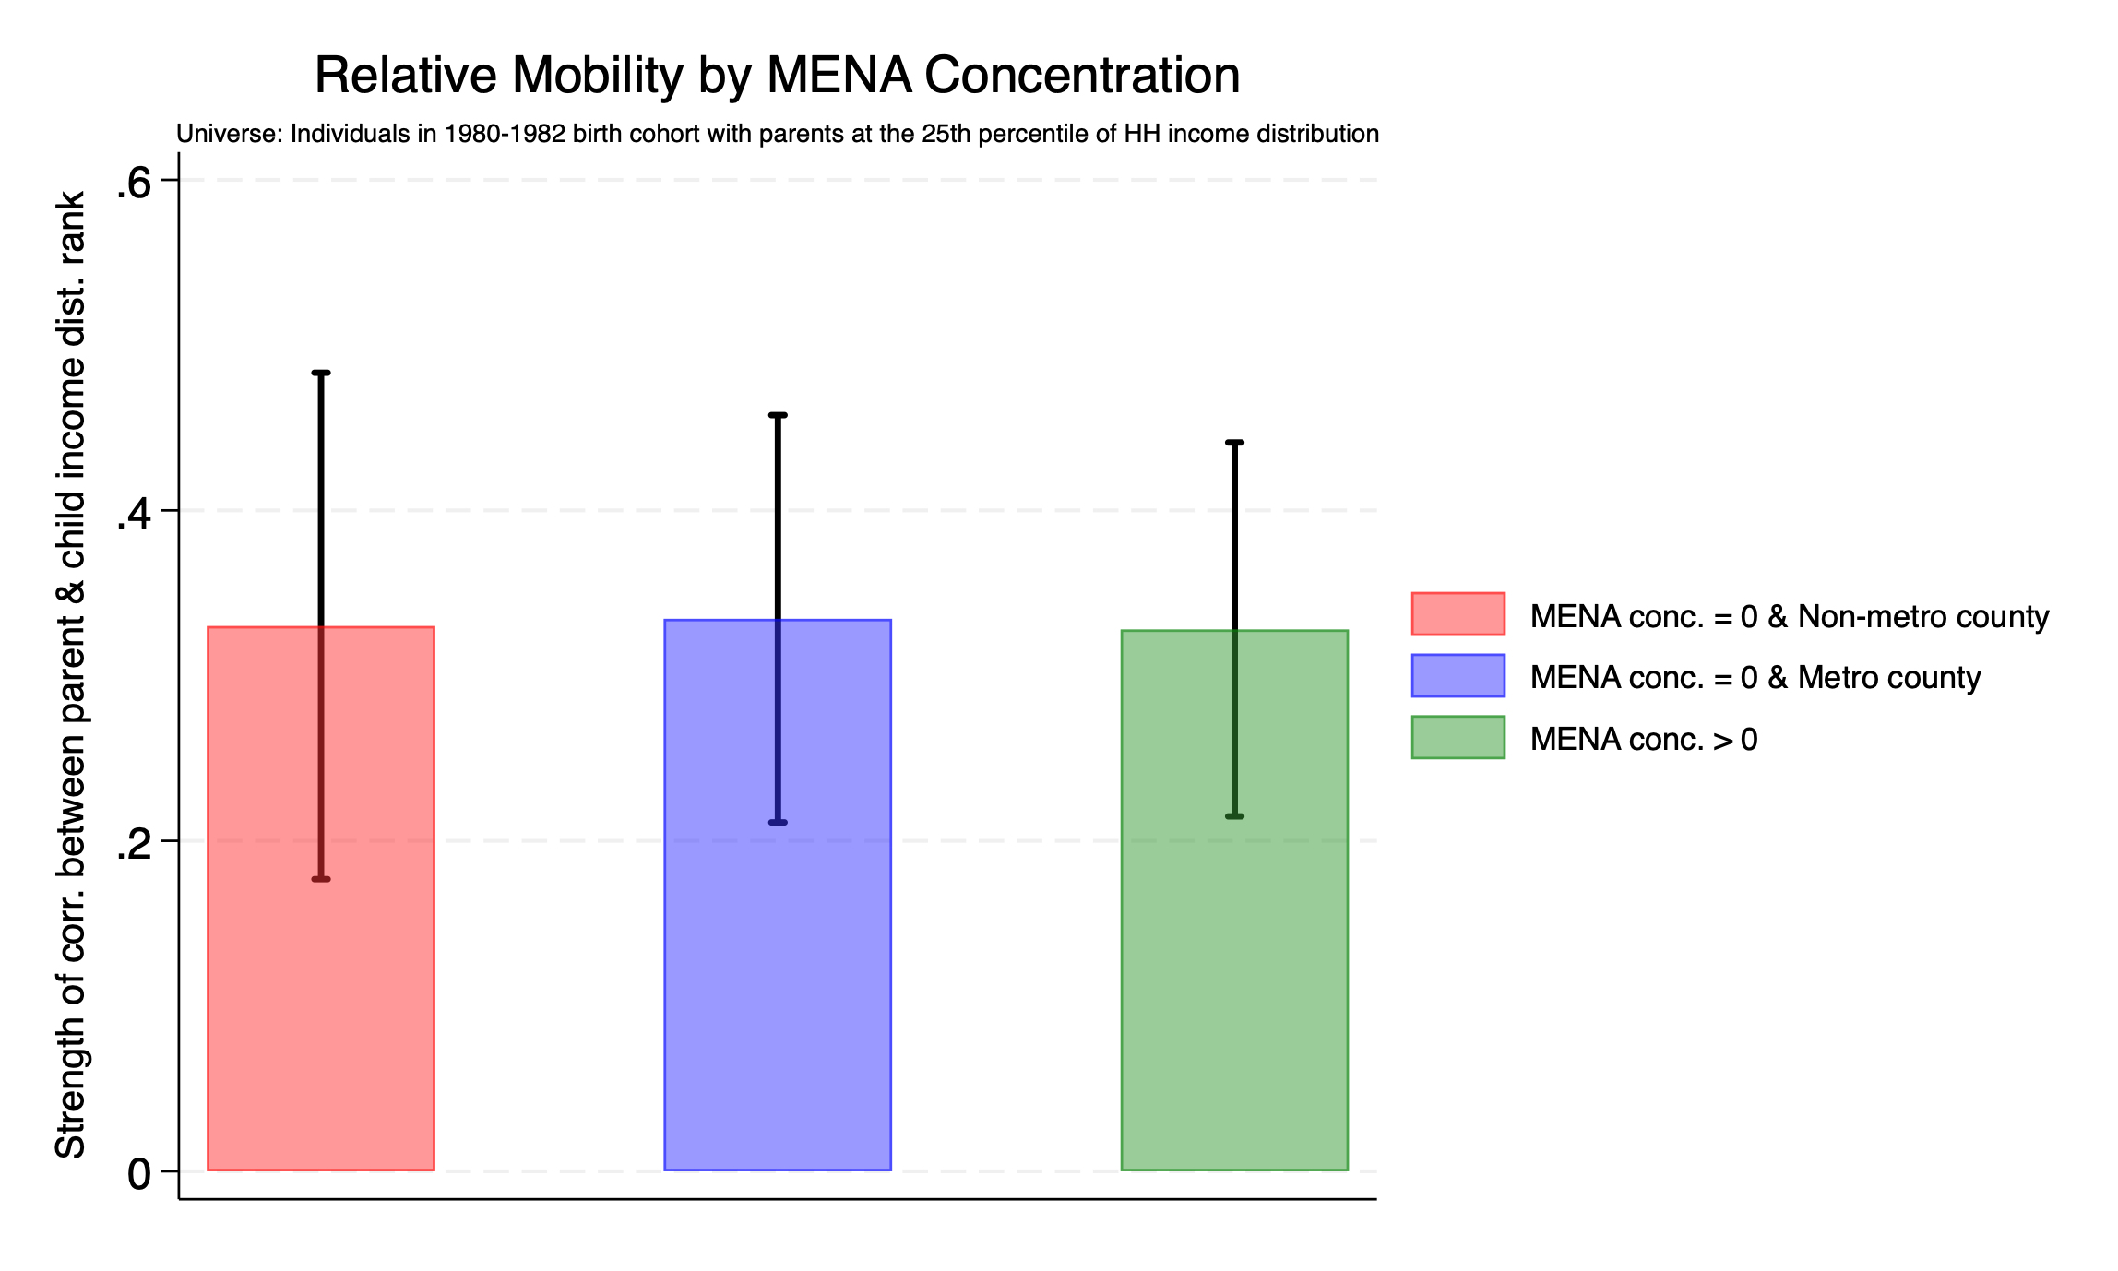

Slide 10
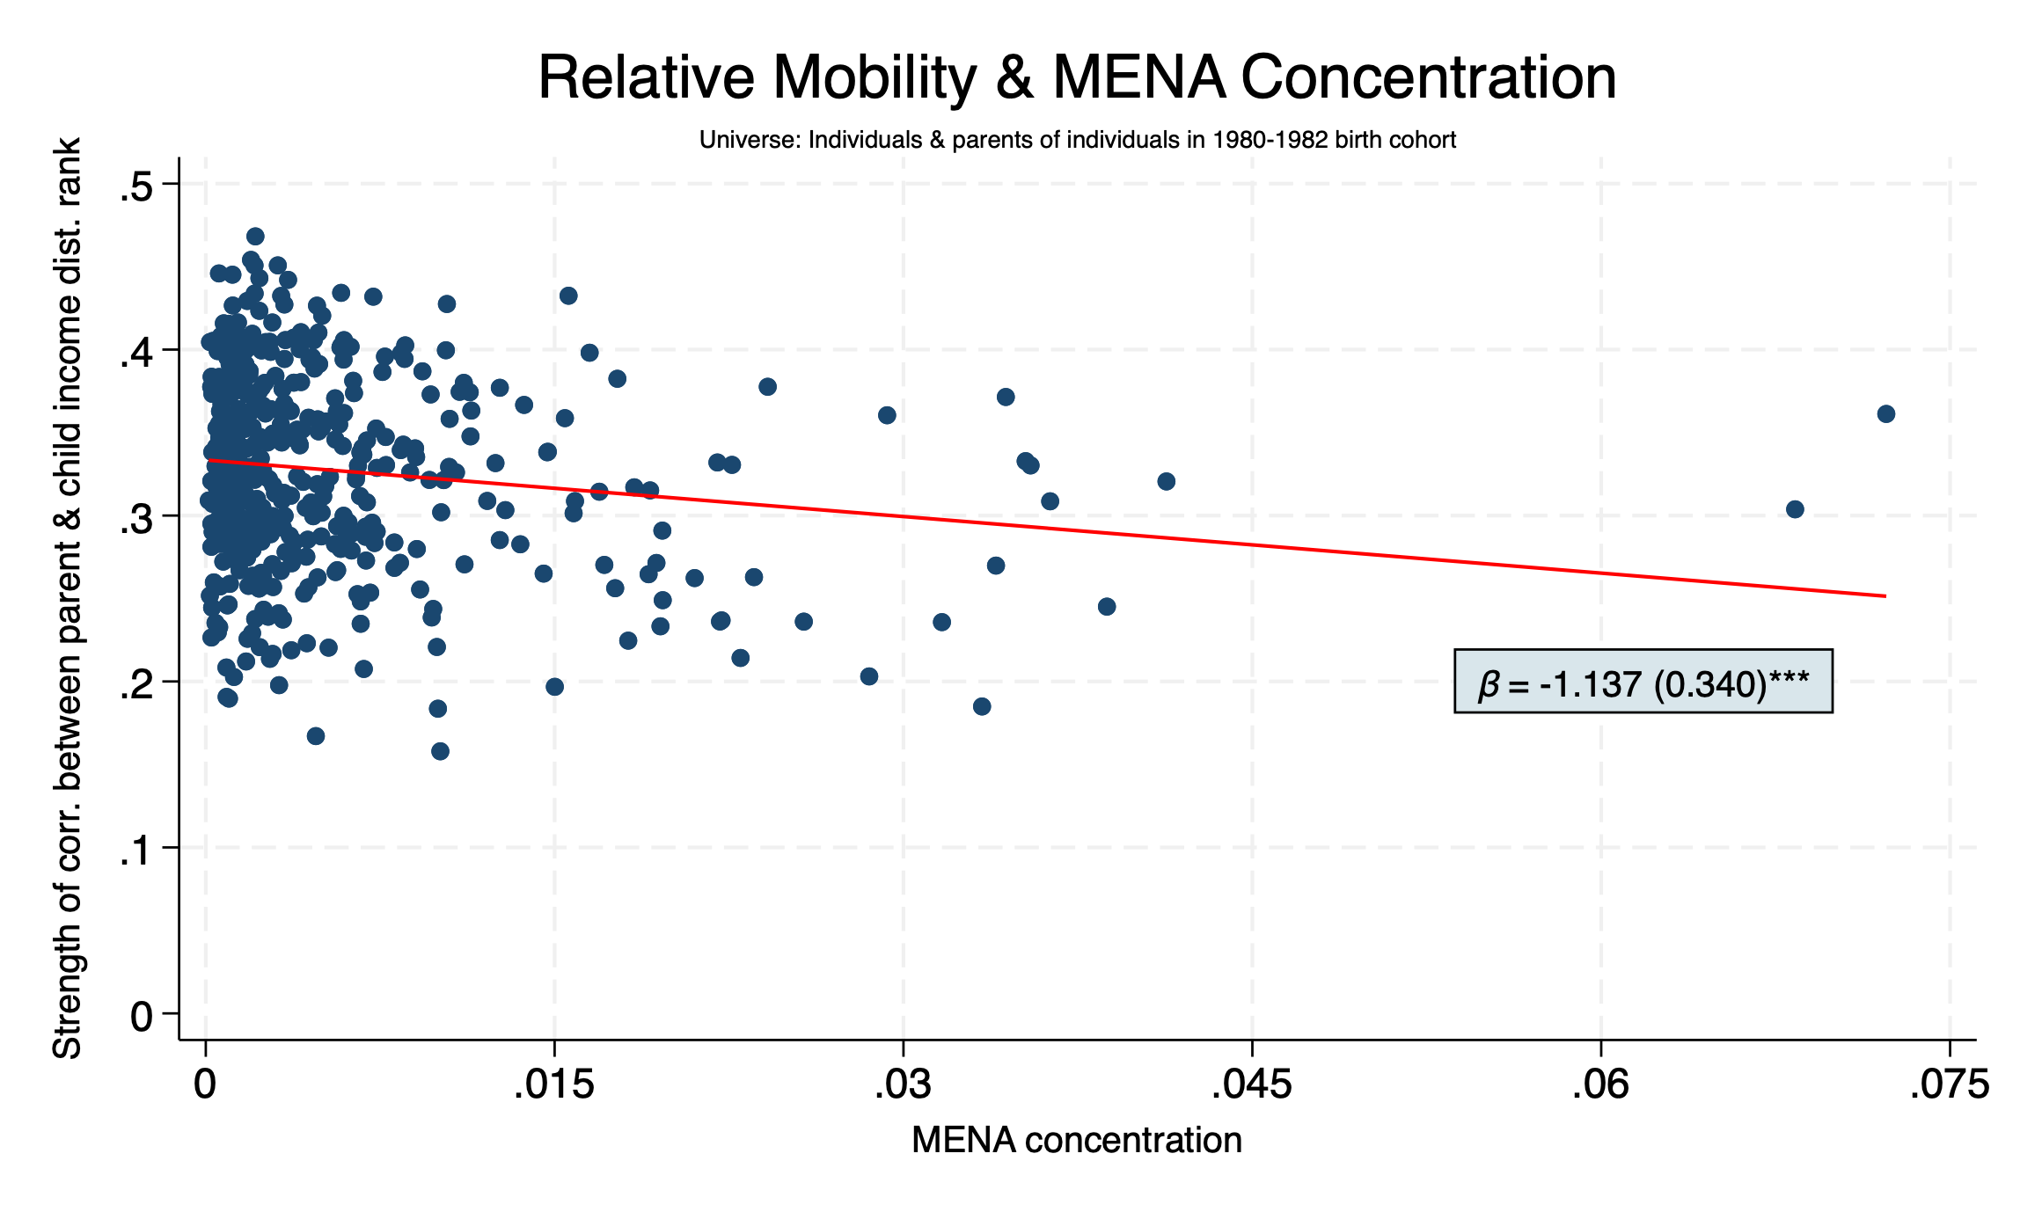
Interpretation of dep. var.:
Slope of OLS regression of child income percentile on the income percentile of their parents
Basically, the higher the value of the slope, the greater chance a child has of rising to a higher income percentile than their parents, regardless of where their parents are on the income distribution.

Slide 11
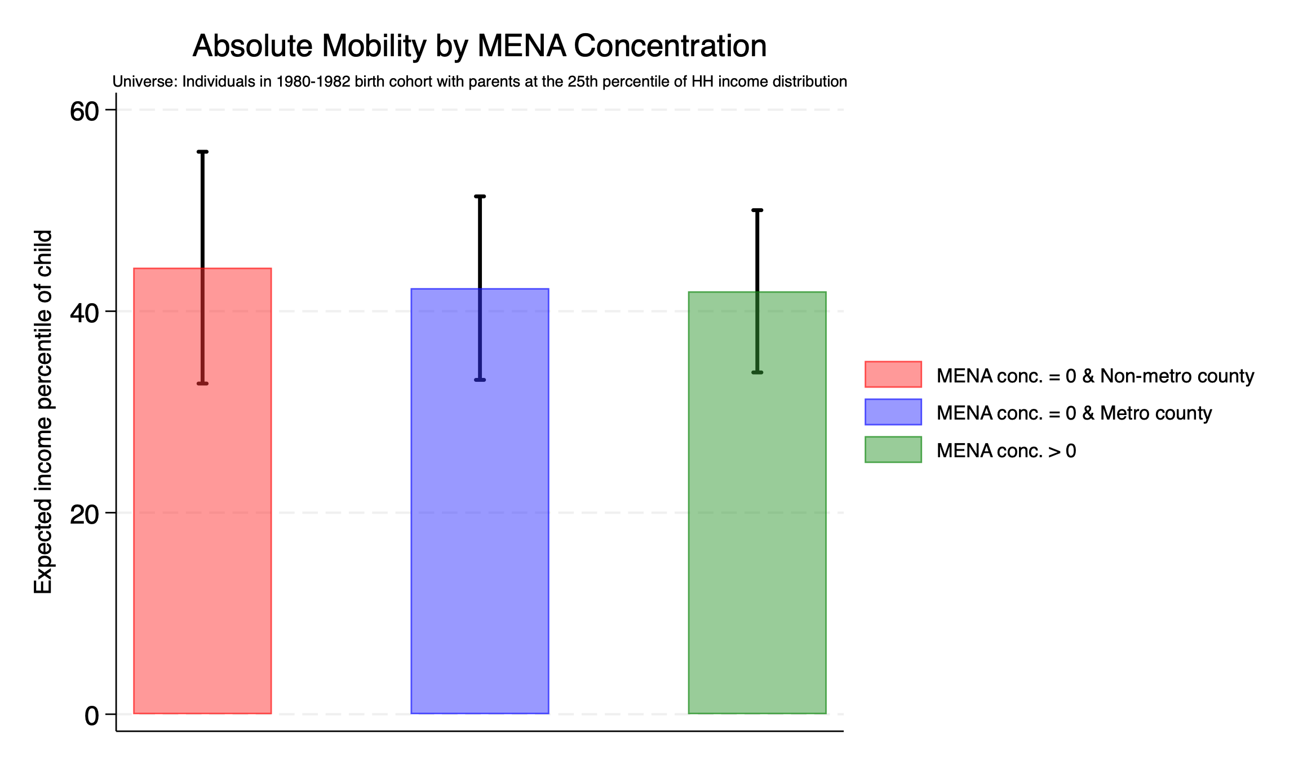

Slide 12
